Slide 1
Employee Data Analysis using Excel
STUDENT NAME: Haren Mariya.X
REGISTER NO: 312214893
Naan Mudhalvan ID: C0986FFC31BDF81895C41CD50C73323E
DEPARTMENT: B.Com (Computer Application)
COLLEGE: Annai veilankanni's college for women

Slide 2
PROJECT TITLE
Employee Performance Analysis using Excel

Slide 3
PROJECT TITLE
Employee Performance Analysis using Excel

Slide 4


AGENDA
Problem Statement
Project Overview
End Users
Our Solution and Proposition
Dataset Description
Modelling Approach
Results and Discussion
Conclusion
3/21/2024 Annual Review

Slide 5

PROBLEM STATEMENT
Our company has two years of sales data, including
figures, categories, and demographics. We need to
use Excel to analyze this data, identify trends, and
understand customer behavior. The goal is to
produce visualizations and insights that will inform
strategies for increasing revenue and improving
marketing efforts

Slide 6

PROJECT OVERVIEW
In a competitive business environment, understanding employee performance is crucial for improving productivity and achieving organizational goals. This project focuses on developing a comprehensive employee performance analysis system using Microsoft Excel. The system will help organizations efficiently track, analyze, and report on employee performance to support better decision-making and enhance overall workforce management.
Objectives:
Data Organization:
  Create a structured Excel template to input and manage employee performance data. This will include details such as productivity metrics, quality of work, attendance records, and peer reviews.
Performance Metrics Definition:
  Identify and define key performance indicators (KPIs) that reflect employee performance accurately. Establish clear criteria for evaluating performance based on these KPIs.
Data Analysis:
  Utilize Excel’s functions, formulas, and pivot tables to analyze performance data. Identify trends, patterns, and outliers to understand performance better and spot areas for improvement.
Visualization and Reporting:
  Develop visual tools such as charts, graphs, and dashboards in Excel to present performance data clearly. Create automated reporting templates to generate regular performance reports with minimal manual effort.

Slide 7

WHO ARE THE END USERS?
Human Resources (HR) Professionals
Managers and Team Leaders
Executives and Senior Leadership
Employees
Data Analysts
Administrative Staff

Slide 8

OUR SOLUTION AND ITS VALUE PROPOSITION
Our Solution
Our solution leverages the powerful data analysis capabilities of Microsoft Excel to provide a comprehensive framework for evaluating employee performance. By utilizing advanced Excel features, we aim to create a robust tool that facilitates performance tracking, trend analysis, and actionable insights.
Value Proposition
1. Enhanced Decision-Making
2. Efficiency and Time-Saving
3. Customization and Flexibility
4. Improved Employee Engagement
5. Cost-Effective Analysis

Slide 9
Dataset Description
"The dataset for our Employee Performance Analysis includes metrics such as employee names, roles, performance ratings, productivity scores, attendance records, and feedback. This comprehensive data allows for detailed analysis and visualization of performance trends, identifying strengths and areas for improvement across the organization."

Slide 10
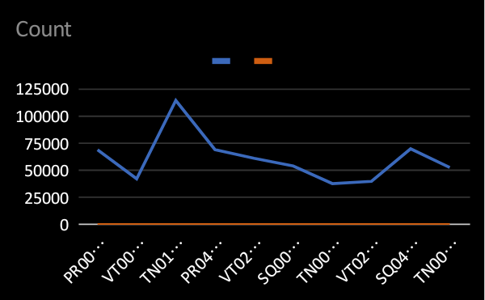

Slide 11

THE "WOW" IN OUR SOLUTION
"Revolutionizing Employee Performance: Our Excel-Based Solution Delivers In-Depth Analysis with Dynamic Dashboards and Predictive Metrics, Empowering Organizations to Optimize Workforce Efficiency, Identify Key Performance Drivers, and Drive Strategic Decision-Making. Discover How Advanced Excel Techniques Uncover Hidden Trends and Transform Data into Actionable Insights for Peak Performance."
3/21/2024 Annual Review

Slide 12
MODELLING
"Modeling Employee Performance with Excel: Our project leverages advanced Excel functionalities to create dynamic performance models, incorporating metrics, trend analysis, and predictive insights. This approach enables precise tracking, forecasting, and strategic management of employee performance, transforming raw data into actionable intelligence for enhanced organizational effectiveness.”

Slide 13
RESULTS
"Results of our Employee Performance Analysis project using Excel reveal actionable insights through comprehensive data visualization and trend analysis. By leveraging advanced Excel features, we identified key performance drivers, optimized workforce management, and provided strategic recommendations, leading to improved employee productivity and organizational efficiency."

Slide 14
CONCLUSION
"In conclusion, our Employee Performance Analysis using Excel effectively uncovered critical performance trends and patterns. The application of advanced Excel techniques enabled precise evaluation and forecasting, leading to actionable insights. These findings support data-driven decision-making, enhancing overall employee productivity and strategic workforce management."

